Slide 1


School of Engineering Technology and Applied Science
The Machine Learning Process
using a decision tree model
Part 04
Reza Dibaj
Notes:
We have covered a lot of ground already, so in this presentation we are going to review and reinforce concepts. First, we will code up a basic pipeline for supervised learning. We will see how multiple classifiers can solve the same problem. Next, we will build up a little more intuition for what it means for an algorithm to learn something from data, because that sounds kind of magical, while it is not really.

Slide 2


Let’s Write a Pipeline
Defining a classifier
“SPAM”
Classifier
Notes:
To kick things off, let’s look at a common experiment you might want to do. Imagine that you are building a spam classifier. In a sense, it is just a function that labels an incoming email as spam or not spam.

Slide 3
Binary Classification
Dataset
How accurate will the classifier act on the new data?
Email | Label
Click here to claim your prize! | Spam
What’s new? | Not spam
Hang out later? | Not spam
You have won $1000,000 | Spam
… | …
Notes:
Suppose you have already collected a dataset and you are ready to train a model. But before you put it into production, there is a question that you need to answer first. How accurate will it be when you use it to classify emails that were not in your training data?

Slide 4
Binary Classification
Dividing the Dataset
Train
Test
Train
Test
Email | Label
Click here to claim your prize! | Spam
What’s new? | Not spam
Hang out later? | Not spam
You have won $1000,000 | Spam
… | …
Email | Label
Pick up groceries | Not spam
Free free free! | Spam
Android 5.0 questions | Not spam
Your appointment | Not spam
Notes:
As best as we can, we want to verify our models work well before we deploy them, and we can do an experiment to help us figure that out. One approach is to partition our data into two parts, and call one part Train and the other Test. We will use Train to train our model and Test to see how accurate it is on new data.

Slide 5
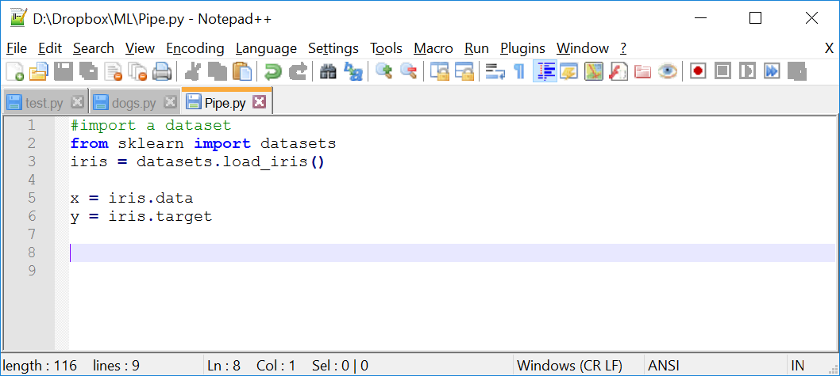
Let’s Write a Pipeline
Import the Iris dataset into scikit-learn
Notes:
What we have not seen before is that I am calling features X and the labels Y.
The code is:
#import a dataset
from sklearn import datasets
iris = datasets.load_iris()
x = iris.data
y = iris.target

Slide 6
Let’s Write a Pipeline
But why is that?
f(x) = y
Features
Label
Notes:
That is because one way to think of a classifier is a function. At a high level you can think of x as the input and y as the output.

Slide 7
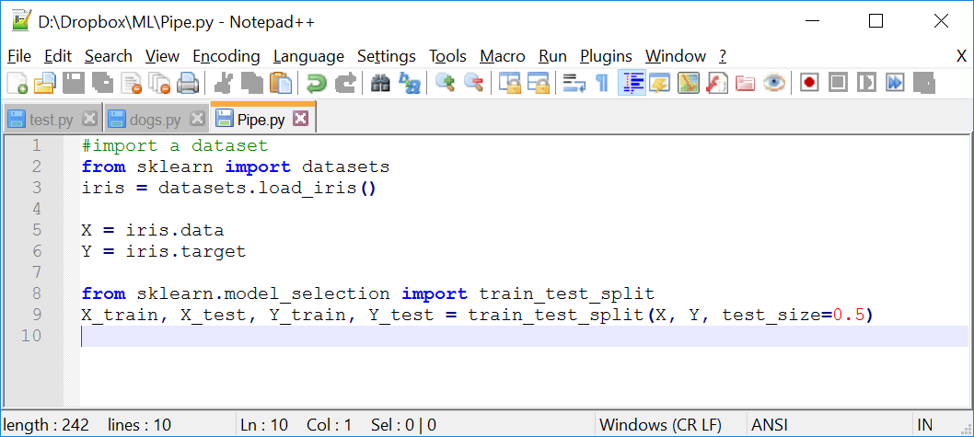
Let’s Write a Pipeline
Let’s continue Iris dataset
Important: sklearn.cross_validation is deprecated, and we should use sklearn.model_selection instead.
Notes:
After importing the dataset, the first thing we want to do is partitioning it into Train and Test.
To do that we can import a handy utility, and it makes the syntax clear.
X_trains and Y_trains are the features and labels for the training set, while X_test and Y_test are the features and labels for the testing set.
test_size = .5 means half the data should be used for testing.

Slide 8
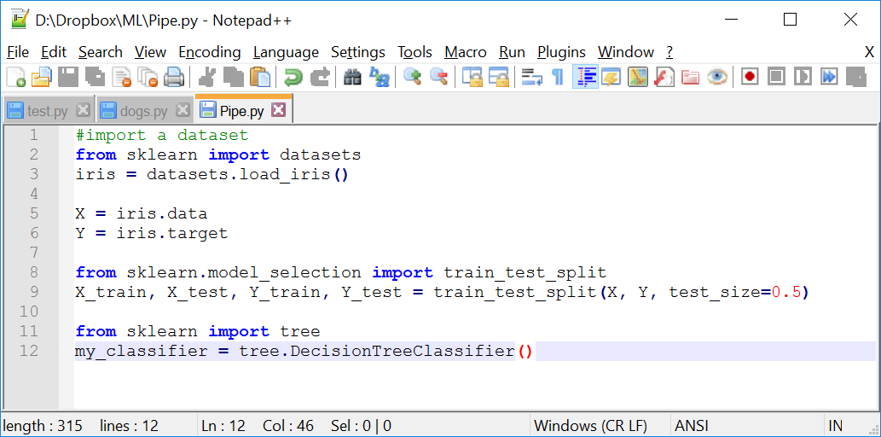
Let’s Write a Pipeline
Let’s continue Iris dataset by creating classifiers
Notes:
Now we create two different classifiers that accomplish the same task.
First we create the decision tree classifier.
The code is as follows:
#import a dataset
from sklearn import datasets
iris = datasets.load_iris()
X = iris.data
Y = iris.target
from sklearn.model_selection import train_test_split
X_train, X_test, Y_train, Y_test = train_test_split(X, Y, test_size=0.5)
from sklearn import tree
my_classifier = tree.DecisionTreeClassifier()

Slide 9
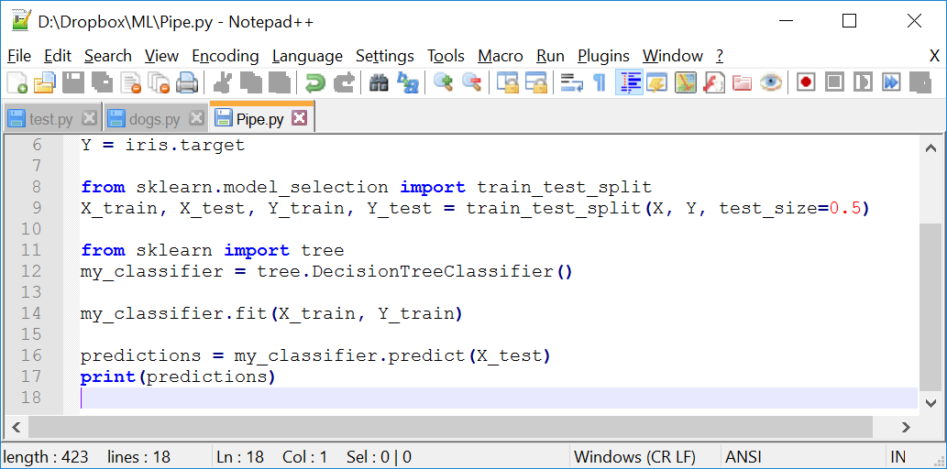
Let’s Write a Pipeline
Let’s train the classifier using our training data:
Notes:
At this point, it is ready to be used to classify data. And next, we will call the predict method and use it to classify our testing data.
The code is as follows:
#import a dataset
from sklearn import datasets
iris = datasets.load_iris()
X = iris.data
Y = iris.target
from sklearn.model_selection import train_test_split
X_train, X_test, Y_train, Y_test = train_test_split(X, Y, test_size=0.5)
from sklearn import tree
my_classifier = tree.DecisionTreeClassifier()
my_classifier.fit(X_train, Y_train)
predictions = my_classifier.predict(X_test)
print(predictions)

Slide 10
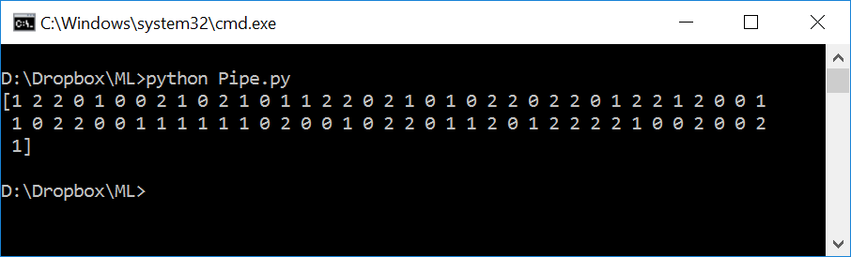
Let’s Write a Pipeline
The result of running the code so far:
Notes:
These correspond to the type of Iris the classifier predicts for each row in the testing data.

Slide 11
Let’s Write a Pipeline
Let’s see how accurate our classifier was on the testing data:
Notes:
Recall that on top, we have the true labels for the testing data.

Slide 12
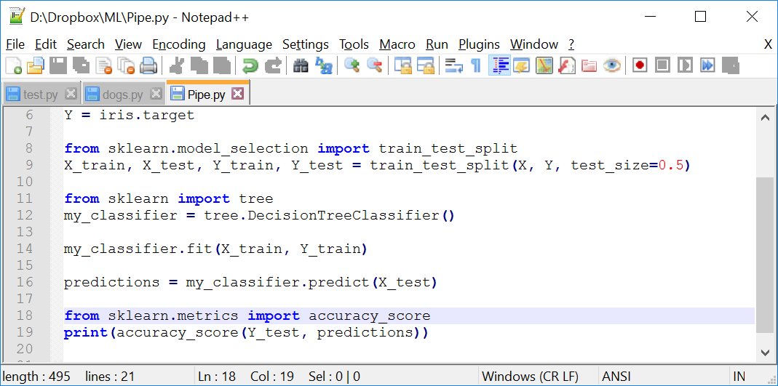
Let’s Write a Pipeline
To calculate our accuracy, we can predicted the predicted labels to the true labels and tally up the scores:
Notes:
There is a convenient method in scikit that we can import to do that.
The code is as follows:
#import a dataset
from sklearn import datasets
iris = datasets.load_iris()
X = iris.data
Y = iris.target
from sklearn.model_selection import train_test_split
X_train, X_test, Y_train, Y_test = train_test_split(X, Y, test_size=0.5)
from sklearn import tree
my_classifier = tree.DecisionTreeClassifier()
my_classifier.fit(X_train, Y_train)
predictions = my_classifier.predict(X_test)
from sklearn.metrics import accuracy_score
print(accuracy_score(Y_test, predictions))

Slide 13
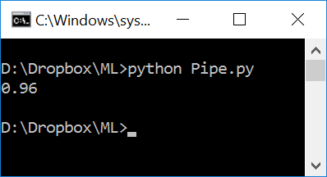
Let’s Write a Pipeline
Let’s run our experiment and see the result:

Slide 14
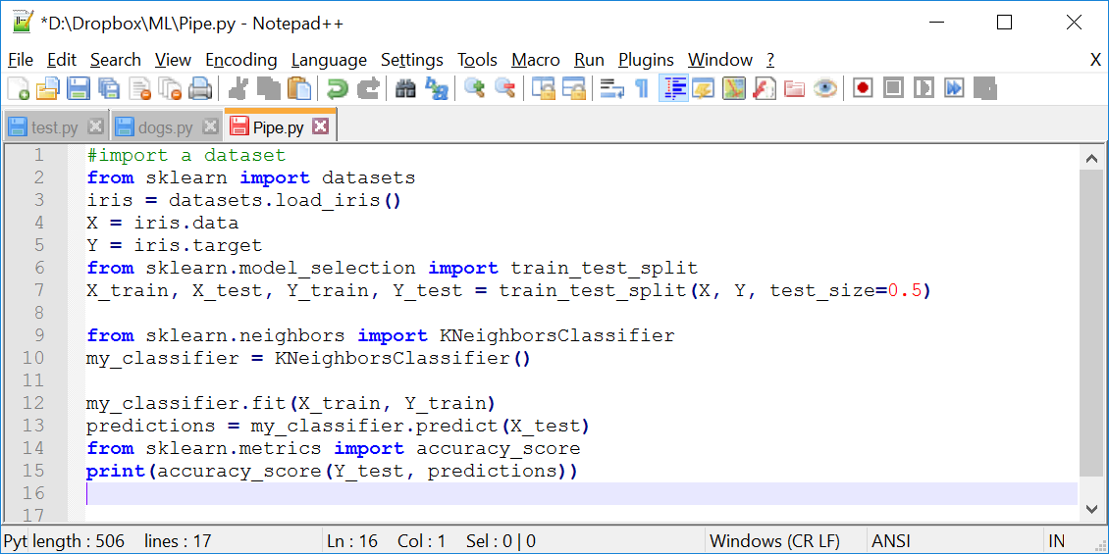
Let’s Write a Pipeline
Replacing the classifier by K-Nearest Neighbors:
Notes:
By replacing just two lines, we can use a different classifier to accomplish the same task. Instead of using a decision tree, we use one called K-Nearest Neighbors.
The code is as follows:
#import a dataset
from sklearn import datasets
iris = datasets.load_iris()
X = iris.data
Y = iris.target
from sklearn.model_selection import train_test_split
X_train, X_test, Y_train, Y_test = train_test_split(X, Y, test_size=0.5)
from sklearn.neighbors import KNeighborsClassifier
my_classifier = KNeighborsClassifier()
my_classifier.fit(X_train, Y_train)
predictions = my_classifier.predict(X_test)
from sklearn.metrics import accuracy_score
print(accuracy_score(Y_test, predictions))

Slide 15
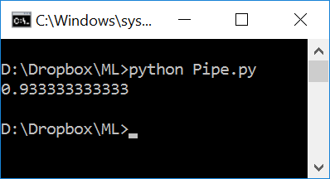
Let’s Write a Pipeline
Let’s run our experiment and see the result:
Notes:
The accuracy maybe different when you run it, because this classifier works a little bit differently. Moreover, because of the randomness in the Train/Test split.

Slide 16
Let’s Write a Pipeline
Replacing the classifier by any sophisticated classifier:
Notes:
Likewise, if you want to use a more sophisticated classifier, we could just import and change those two lines that we have already replaced once by K-Nearest Neighbors.
The takeaway here is that while there are many different types of classifiers, at a high level, they have a similar interface.

Slide 17
Let’s Write a Pipeline
What does it mean to learn from data?
f(x) = y
Features
Label
def Classify(features):
# do some logic
return label
Notes:
Earlier, we mentioned that we call the features X and the labels Y, as they were the input and output of a function.
As we already know in supervised learning, we do not want to write this function ourselves. We want an algorithm to learn it from training data.
So, what is it mean to learn a function?

Slide 18
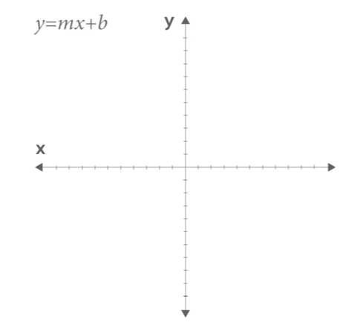
Let’s Write a Pipeline
What does it means to learn a function?
Notes:
So, what does it mean to learn a function?
Function is just a mapping from input to output values.
Here is a function you might have seen before:
y = mx+b
That is the equation for a line, and there are two parameter: m which gives you the slope; and b, which gives you the y-intercept.

Slide 19
Let’s Write a Pipeline
What does it means to learn a function?
Notes:
Given these parameters, of course, we can plot the function for different values of x.

Slide 20
Let’s Write a Pipeline
How a classifier works as a function?
x
def Classify(features):
# do some logic
return label
y
Notes:
In supervised learning, our classified function might have some parameters as well.
But the input x are the features that we want to classify, and the output y is a label, like Spam or Not Spam, or type of flower.

Slide 21
Let’s Write a Pipeline
What could the body of the function look like?
def Classify(features):
# do some logic
return label
Notes:
What could the body of the function look like?
That is the part that we want to write algorithmically, or in other words learn.
The important thing to understand here is we are not starting from the scratch and pulling the body of the function out of thin air. Instead, we start with a model.
You can think of a model as the prototype for or the rules that define the body of our function.

Slide 22
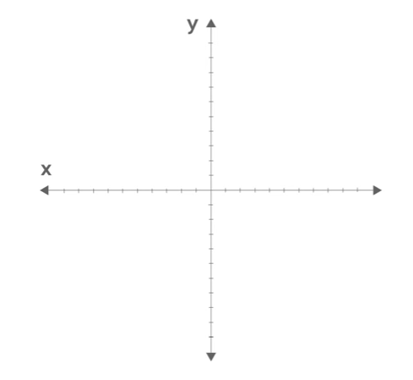
Let’s Write a Pipeline
Distinguishing between red dots and green dots:
Notes:
Typically, a model has parameters that we can adjust with our training data.
And here is a high-level example of how this process works.
Let’s look at a toy dataset and think about what kind of model we could use as a classifier.
Pretend we are interested in distinguishing between red dots and green dots, some of which I have drawn here on a graph. To do that we will use just two features: the x and y coordinate of a dot.

Slide 23
Let’s Write a Pipeline
How we can classify any data?
Red or green?
Notes:
Now let’s think about how we could classify this data. We want a function that considers a new dot that has never seen before, and classifies it as red or green.
In fact, there might be a lot of data we want to classify.

Slide 24
Let’s Write a Pipeline
How we can classify any data?
Notes:
Here I have drawn our testing examples in light green and light red. These are dots that were not in our training data. The classifier has never seen them before, so how can it predict the right label?

Slide 25
Let’s Write a Pipeline
How we can classify any data?
Classifier
Notes:
Imagine if we could somehow draw a line across the data.
Then we could say the dots to the left of the line are green and the dots to the right of the line are red.
The question is: How can we learn this line?

Slide 26
Let’s Write a Pipeline
How we can classify any data?
m = 2
b = 1
Notes:
One way is to use the training data to adjust the parameters of a model.
And the model we use is a simple straight line like we saw before. In other words, we have two parameters to adjust: m and b
And by changing them, we can change where the line appears.

Slide 27
Let’s Write a Pipeline
How could we learn the right parameters?
One idea is that we can iteratively adjust the parameters using the training data
Notes:
For example, we might start with a random line and use it to classify the first training example. If it gets it right, we do not need to change our line, so we move on to the next one.

Slide 28
Let’s Write a Pipeline
How could we learn the right parameters?
Notes:
But on the other hand, if it gets wrong, we can slightly adjust the parameters of our model to make it more accurate.
The takeaway here is this: One way to think of learning is using training data to adjust the parameters of a model.

Slide 29
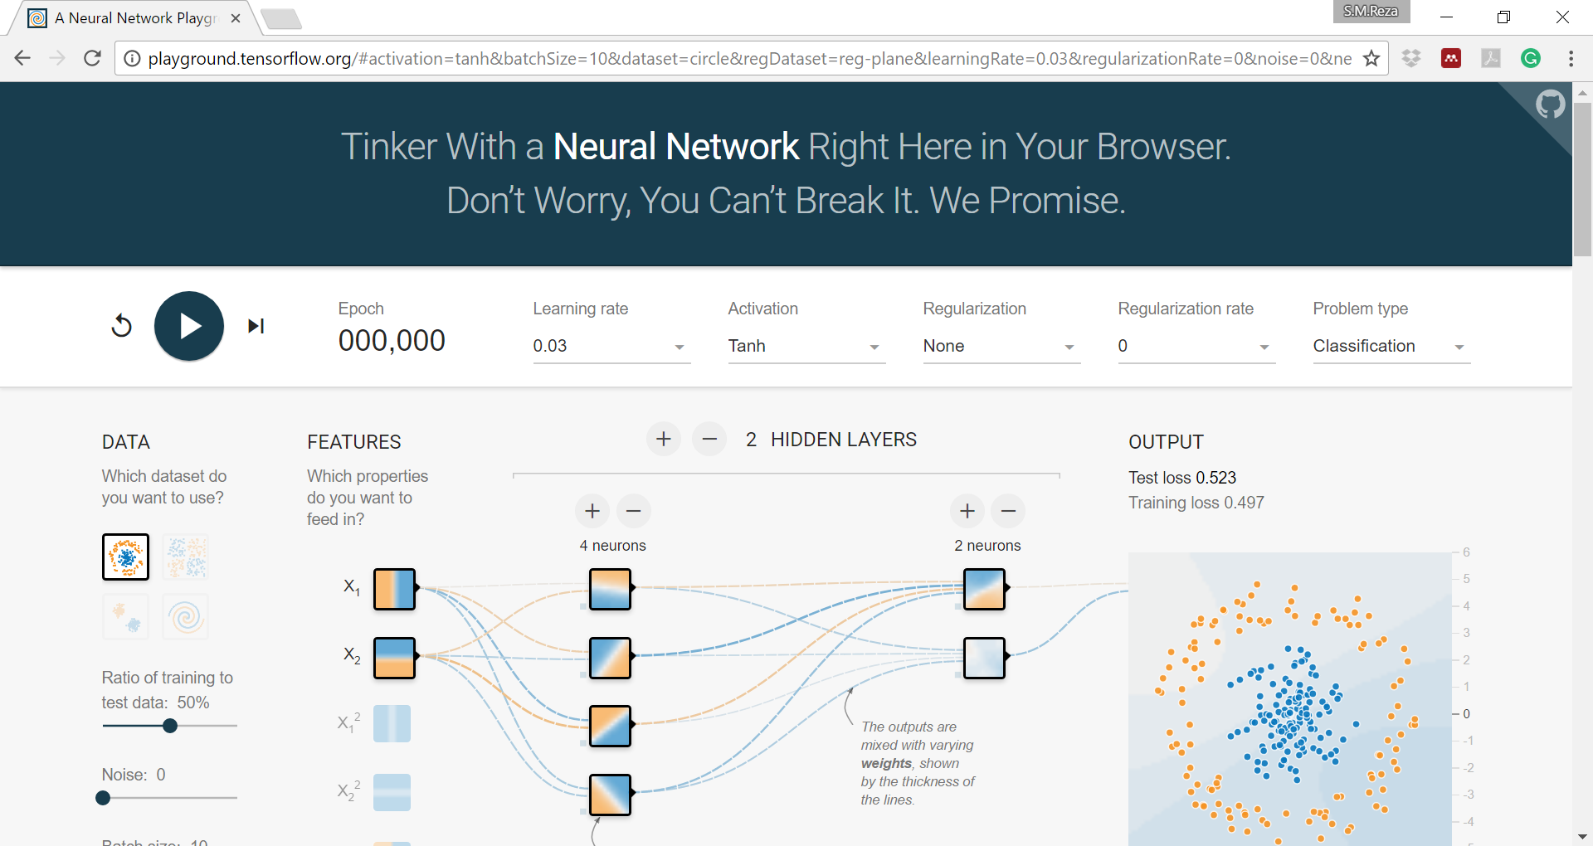
Let’s Write a Pipeline
http://playground.tensorflow.org
Notes:
Now, here is something special that is called TensorFlow/playground.
http://playground.tensorflow.org
This is a beautiful example of a neural network you can run and experiment with right in your browser. It is awesome!
The playground comes with different datasets that you can try out.
Some are very simple and can be classified by using a simple line. Some datasets are much more complex. One of them is especially hard and see if you can build a network to classify it.
We can think of a Neural Network as a more sophisticated type of classifier, like a decision tree or simple line, but in principal the idea is similar.

Slide 30
Thank you

